Slide 2
Motivation
Floods are a source of concern because they cause loss of life and billions in damages [5].
Affects agriculture, water management, safety, engineering/construction of waterways [6].
Commercial detection systems exist but they are very expensive and many communities cannot afford them [9].
Notes:
Explain flood damage- not work of others.

Slide 3
Problem Statement
Creating a low-cost solution to detect changes in water level and predict flood, using Raspberry PI and a Camera module
Notes:
Explain flood damage- not work of others.

Slide 4
A better solution is needed
Measuring water level can be expensive.
USGS study shows capital cost between $5,000-$10,000[1]
A study claims the cost of installation to be $300,000[2]
Existing methods work but can be affected by various anomalies [3]
stilling well- bias errors, high maintenance cost
ultrasonic- sensitive to temperature, and high waves
pressure gauges- seasonal shift

Slide 5
Project Objective
Create a sensor that is able to visually interpret and record data.
Use visual data to indicate flood status
Certain change in measurement values indicates flood
The sensor should be autonomous
Can work with a battery module and solar panel
Can upload data to the cloud
Cellular Connectivity
Upload
Power (Solar + battery)
Google Cloud (Data Repository)
Camera
PI
Sensor
Notes:
I don’t want to ramble here. Need to explain that end goal is a quick response.

Slide 6
Methodology and Contributions
(My contributions in the overall project are in red)
Building a prototype with PI, camera, cellular connectivity module, solar panel and battery module <- Partial contribution
Tuning power parameters
Configure network connectivity
Create program to measure water level
Configure remote storage on Google Cloud and upload Data
Deployment
Notes:
- Clear explain

Slide 7
Contribution 1: Building a prototype with PI and camera
Assembling the Raspberry PI (RPI) components
I ensured the battery and LTE Cellular modules work with the RPI
Several Initial problems
PiJuice battery module
Sensitive to shock and vibration
Low charge shutoffs
Reboots with many peripherals
and more….
LTE module
need to manually create network interface
need to manually configure services
Where to store data?
need cloud storage
Will elaborate on each of these in the next slide
Result: The Raspberry PI works with PIJuice and LTE module

Slide 8
Contribution 2: Configuring PiJuice Battery Module
First task -
Run program, determine battery life expect.
Record which peripherals worked together
Record observations
power overflows
flags
system task scripts
Encountered several errors and need to handle them
Possible errors: Software (e.g., SSL) errors, water level detection error, hardware etc.
Developed scripts that
manage device with shutdown and wake up
integrate with OS and crontab
create SSH and VNC tunnels to study remote placements
Notes:
autonomous

Slide 9
Adding a Solar Panel
Even with tuning, the battery alone was not enough to keep the sensor running more than 2 hours
Added a small solar panel
First solar panel was 3.5W 5V
could only charge the Pi in small bursts with full sunlight
also needed the Pi should be fully shut down.
Added a larger panel
Can keep the sensor on for more than 12 hours
Battery still drains after 3-4 hours once the solar stops charging
Need larger battery
Tuned the battery parameters further to keep it running longer
We can now keep the PI up the whole day and 3-4 hours after sunset

Slide 10
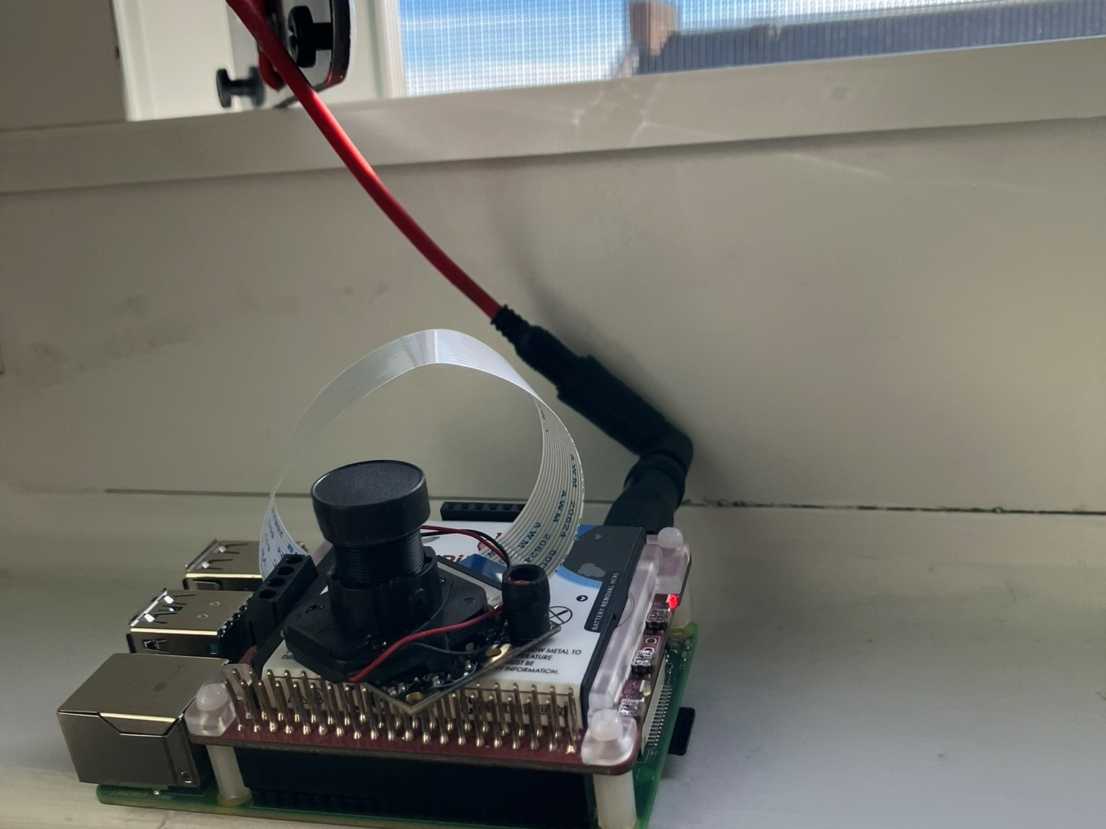
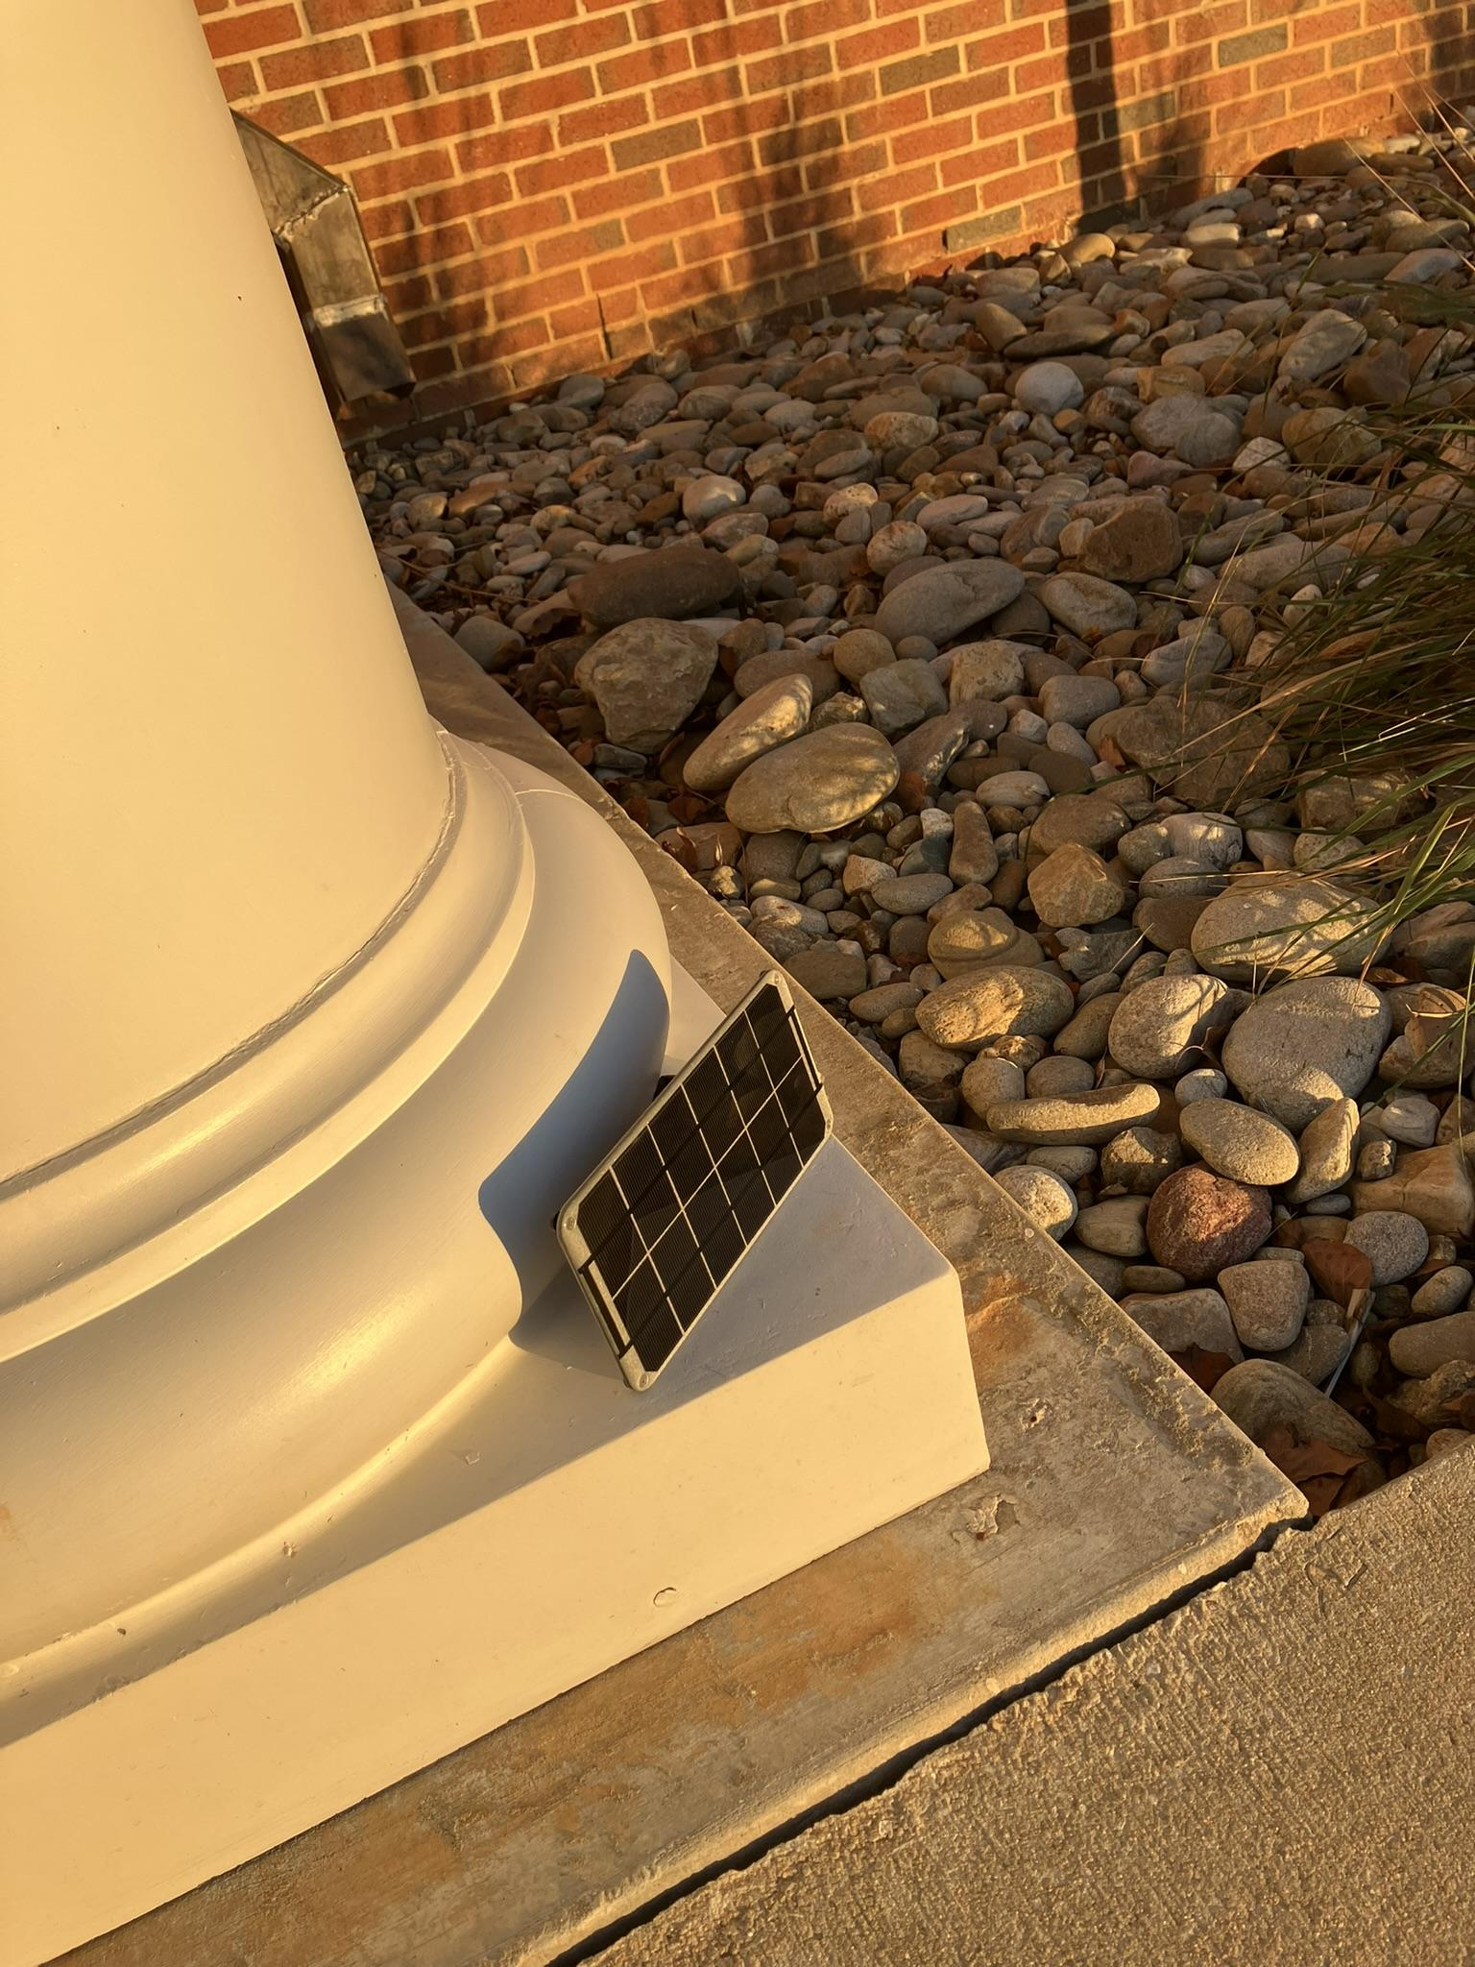
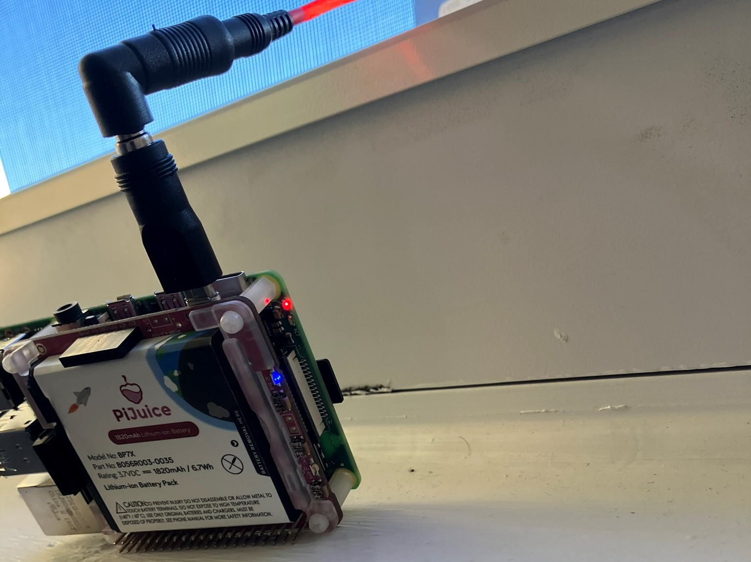
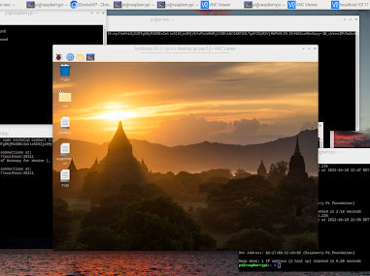
Configuring Solar Panel
v
Initial testing:
Device must be powered off to receive any level of charge
LEDs can indicate status, remote connection for details
More information new solar panel

Slide 11
Contribution 3 - Wireless HAT
Goal -
Automatically connect to the cellular network after boot-up
Problem:
Needed to manually create the network interface
Needed to manually start network services at a particular time for it to work
Solution:
Created a set of scripts to automate connectivity

Slide 12
Configuring Network Connectivity
Investigated the best network provider in our area
T-Mobile
Configured LTE module to work it
Created Point to Point Network Interface
Advantages: suffers less from “last-mile” connectivity
Tested and confirmed functionality in local lab
Used commands to obtain and check career info, signal strength, and other parameters
Checked connectivity using “ping” utility
Consolidated the steps in a script to automate network connectivity after reboot
Automatically create a cellular interface and run service to activate it
Activate route to the Internet
Check Connectivity using ping

Slide 13
Autonomous Program
Findings:
Best way to use pon (modem ) is to direct pon to use the configuration file for our APN.
Route can be automatically created
Connection should be created in background script with root privilege
Device connects to network on startup and works for ~2-3 seconds and can reset after startup
Sometimes the connection resets after startup, pon provider will try again in the background
Best way to ensure reliable connectivity is to wait ~30 seconds after boot-up with a terminal
Results - The PI is able to connect to the cellular network automatically
Caveat - The PI is currently using WiFi to upload data. We need to test seamless switching between WiFi and Cellular.

Slide 14
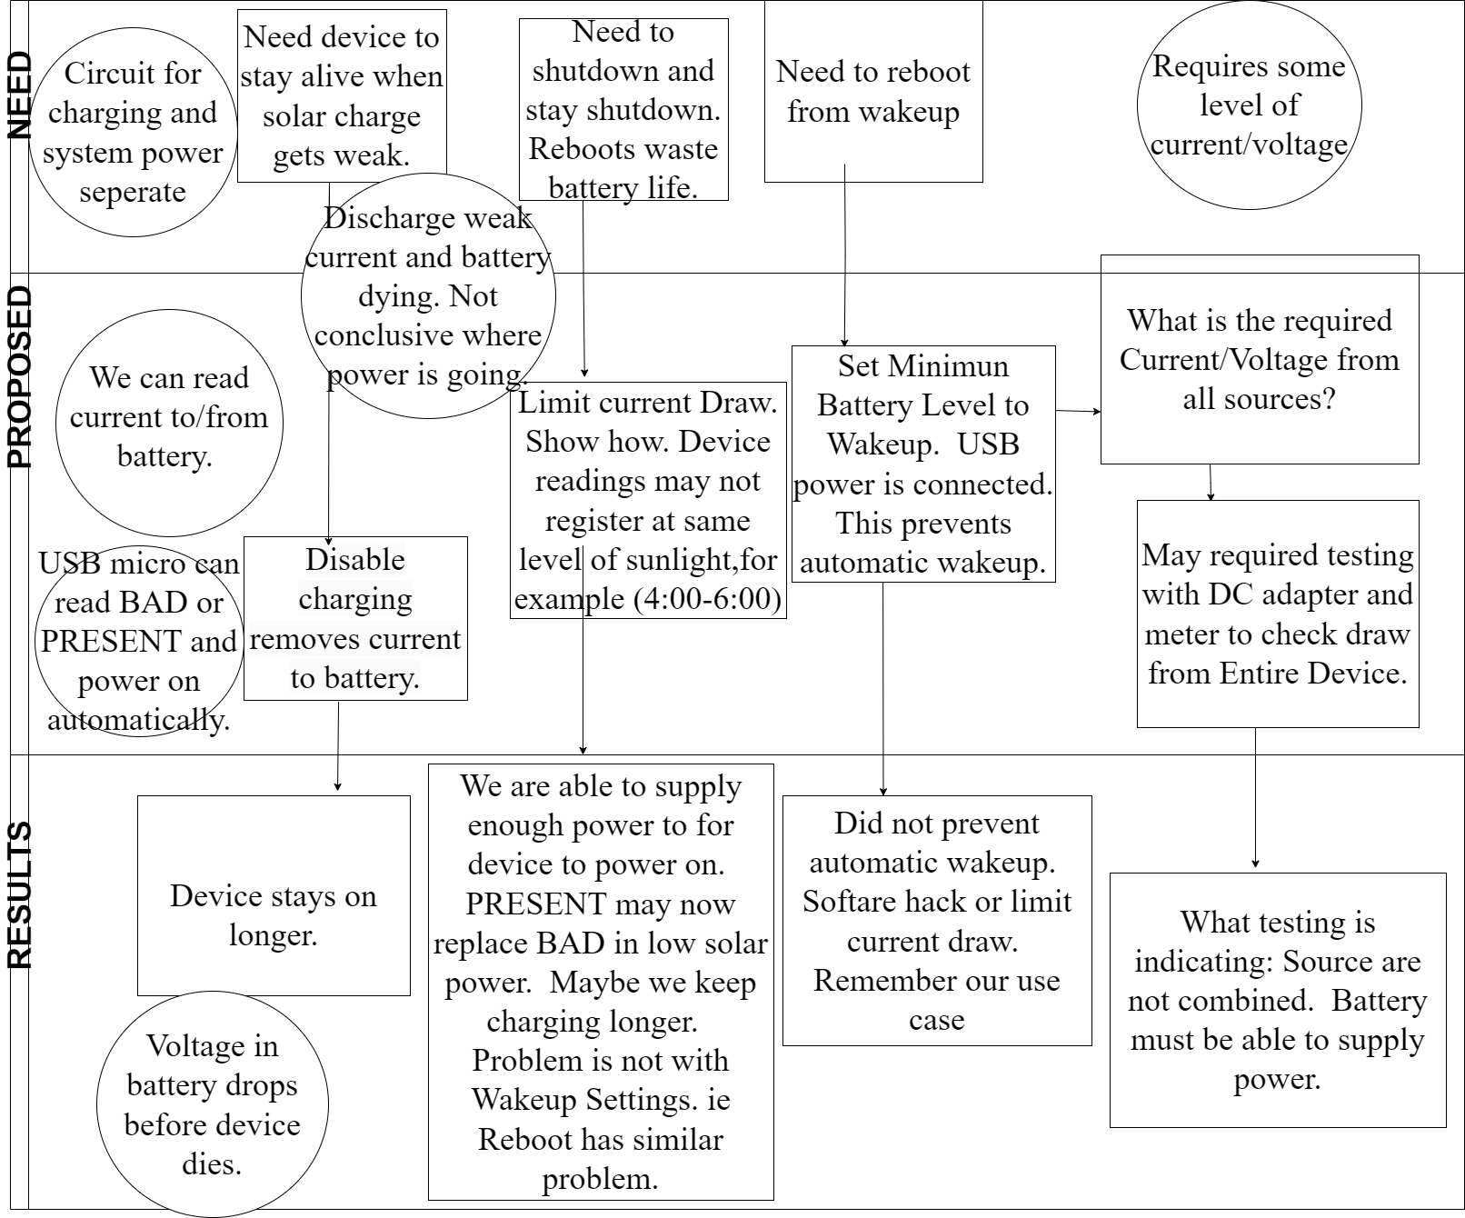
Reading this Chart
Circle: What we know.
Box: Follow Depth in chart.

Slide 15
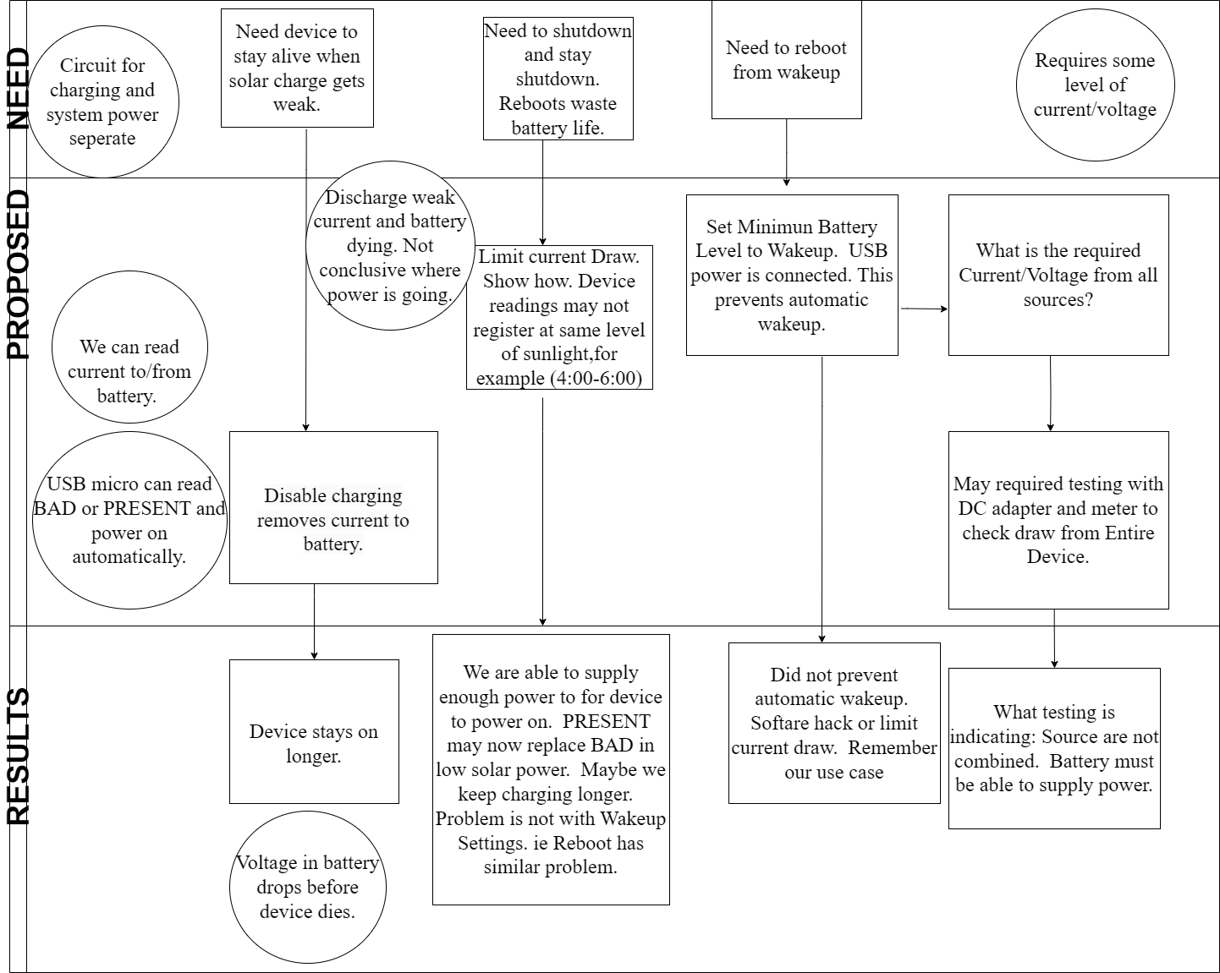
Reading this Chart
Circle: What we know.
Box: Follow Depth in chart.

Slide 16
Tuning Battery Parameters- Findings
Findings:
The battery module needed several tests and tweaks
Tuned multiple parameters to optimize battery usage by automating device shutdown and wake-up
battery state (present vs connected)
charge level
current draw
Results -
The PI is able to work with battery and solar.
It stays on for about 3-4 hours after sunset.
Still needs larger battery

Slide 17
Methodology and Contributions
(My contributions in the overall project are in red/yellow)
Building a prototype with PI, camera, cellular connectivity module, solar panel, and battery module <- Partial contribution
Configuring PiJuice module
Configure network connectivity
Create program to measure water level
Configure remote storage on Google Cloud and Upload Data
Deployment
Notes:
- Clear explain

Slide 18
Contribution 4 - Integrate with Cloud Storage
Goal - Upload data to cloud for long term storage and analysis
Several steps are needed to upload data to Cloud
Configured Service Account Authentication via Google Cloud API (rather than password)
More functionality than API Keys
Run from the command line without having to use a browser
User is not involved in the consent
Program can either use mimeType text/plain or image/png
Created naming scheme of files
Developed program to upload, list, search and download file(s)
Program to create and organize within folders

Slide 19
Contribution 4 - Integrate with Cloud Storage
Goal - Upload data to cloud for long term storage and analysis
Program to parse through data files
Matplotlib programs to visually represent scatter plots adding color, legend, and specified intervals
Results- Created a program to upload and store data on Google Cloud.
This program has been tested and is periodically uploading pictures taken by the sensor.

Slide 20
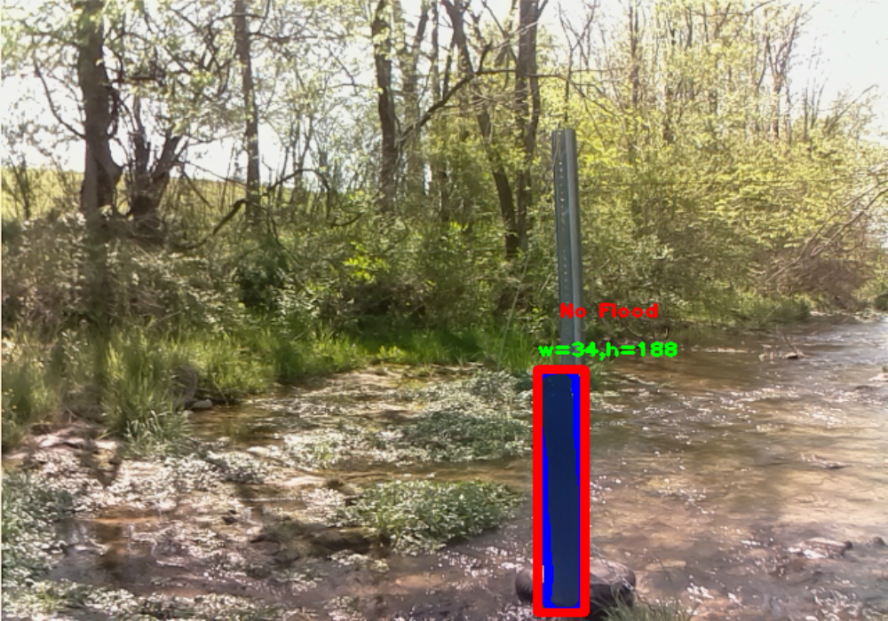
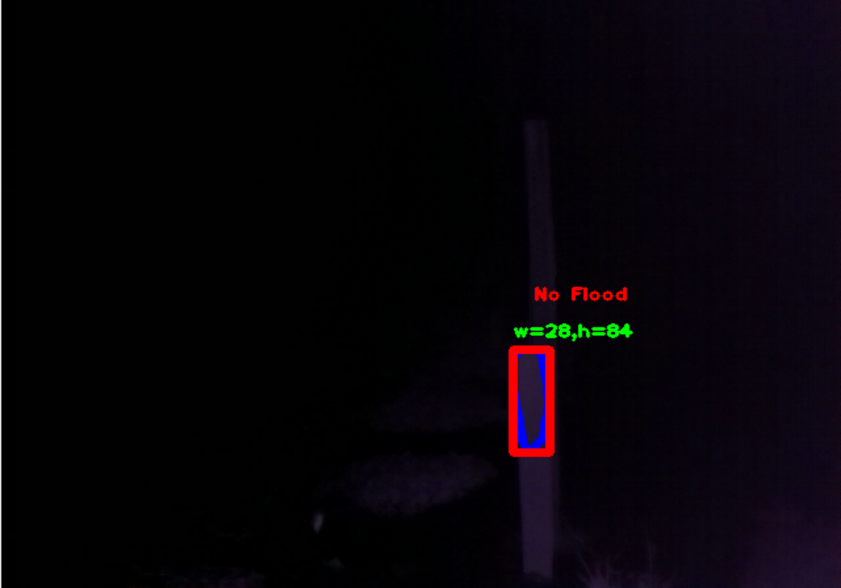
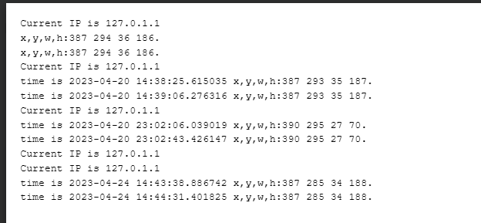
Uploading Data Works!
We can automatically upload pictures and logs.

Slide 21
Summary - What did I accomplish?
Goal | Status | Notes
Building a prototype with PI and additional modules | Done | Configured the LTE hat and PI Juice module
Configuring PiJuice Module | Done | The PI is now powered by the PiJuice and a solar panel
Configured network connectivity | Done | Created a set of scripts to automate network connectivity
Upload data to cloud storage | Done | Created a set of scripts and configurations to upload data automatically to the cloud storage

Slide 22
Future work
Battery issue is the main bottleneck in this project
Works with all the peripherals BUT
We need larger battery and further optimize current draw
We have tested cellular connectivity and WiFi works
We need to test the cellular connectivity and WiFi working together

Slide 23
References
Fulton, John W., et al. "Near-Field remote sensing of surface velocity and river discharge using radars and the probability concept at 10 US geological survey streamgages." Remote Sensing 12.8 (2020): 1296.
Hiroi, Kei, and Nobuo Kawaguchi. "FloodEye: Real-time flash flood prediction system for urban complex water flow." 2016 IEEE SENSORS. IEEE, 2016.
Intergovernmental Oceanographic Commission. Manual on Sea-level Measurement and Interpretation: Volume 3. Intergovernmental Oceanographic Commission (IOC) of UNESCO, 2002.
PiJuice, https://github.com/PiSupply/PiJuice/tree/master/Hardware /#power-management-and-batteries, Last Accessed: May 02, 2023
Arshad, Bilal, et al. "Computer vision and IoT-based sensors in flood monitoring and mapping: A systematic review." Sensors19.22 (2019): 5012.
Zhang, Zhen, et al. "In-situ water level measurement using NIR-imaging video camera." Flow Measurement and Instrumentation 67 (2019): 95-106.
PON, https://manpages.ubuntu.com/manpages/bionic/man1/pon.1.html, Last Accessed: May 02, 2023

Slide 24
References
Klemas, Victor. "Remote sensing of floods and flood-prone areas: An overview." Journal of Coastal Research 31.4 (2015): 1005-1013.
Ogie, Robert Ighodaro, et al. "Optimal placement of water-level sensors to facilitate data-driven management of hydrological infrastructure assets in coastal mega-cities of developing nations." Sustainable cities and society 35 (2017): 385-395.

Slide 25
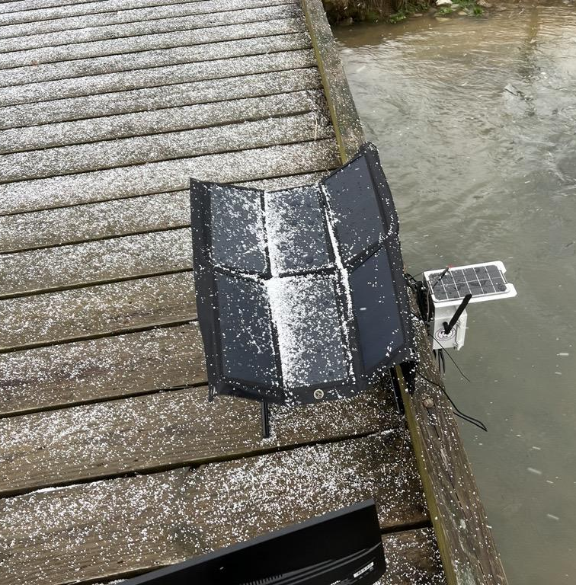
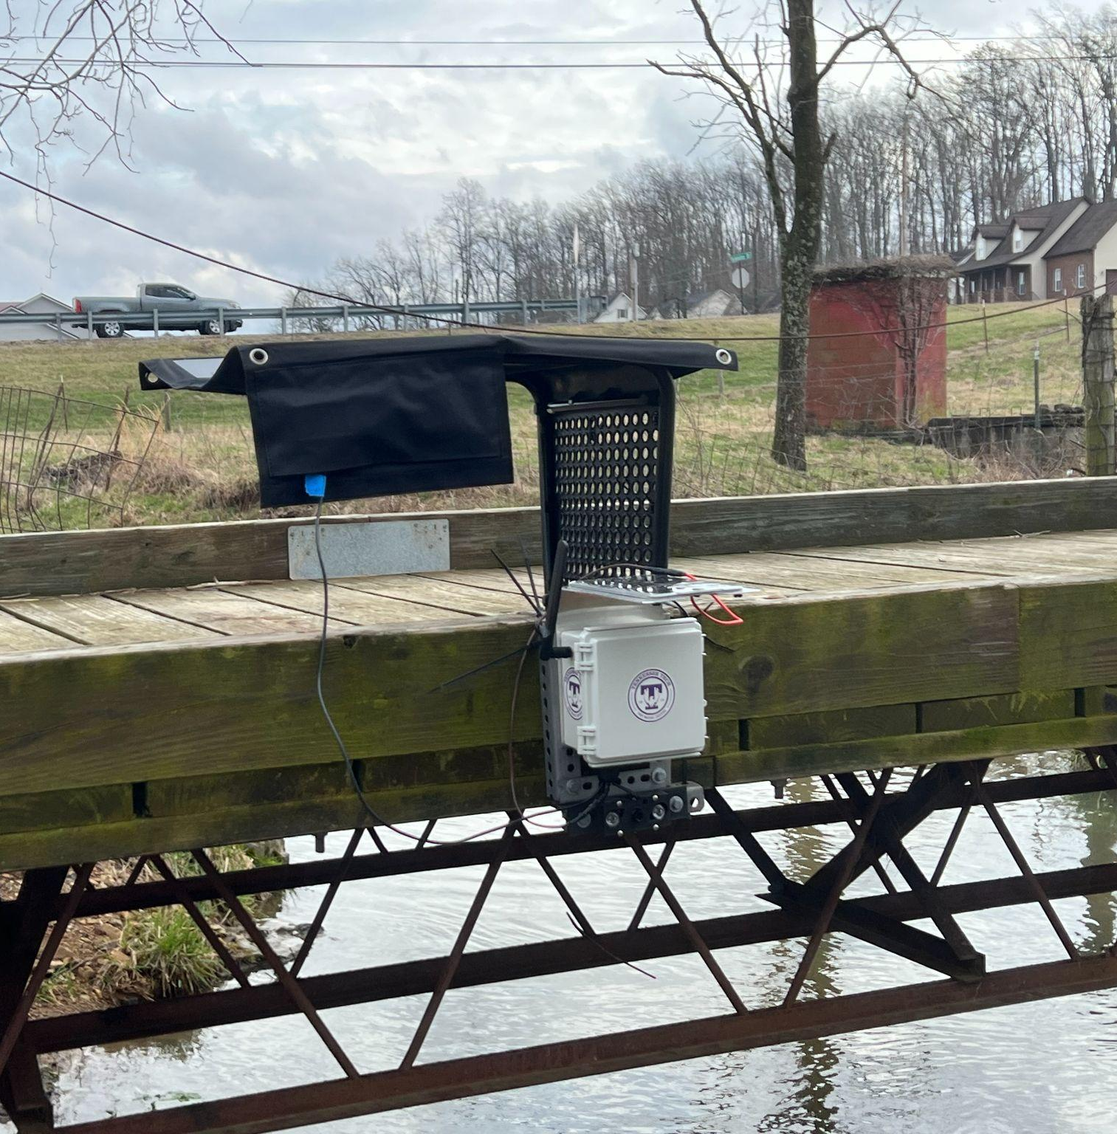
Presentation of FEWS
This is the Flood Early Warning System (FEWS)
TNTECH Computer Science with the guidance and support of Civil Engineering Department.
FEWS is based on a RPI 4 system with low cost making this a cost effective and worthwhile solution.

